Slide 1

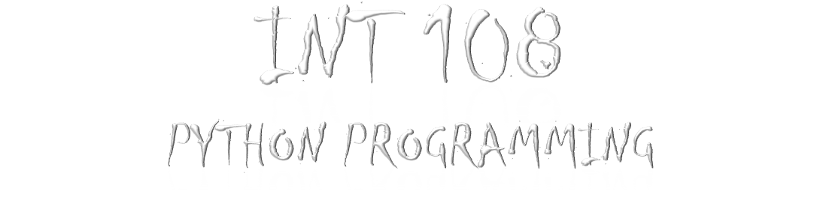


Slide 2

Question….>>
You need to write a python script that generates an acronym word form a given sentence.
Take multiple strings as input in the form of list.
Add the first letter of each string to output.
Iterate over the complete string and every next letter to space to output.
Change the output to upper case (acronym).
You have to generate acronym for all given strings.
(Students are free to decide the input and output layout for this mini project)
HINT : You can use split and indexing to fetch the first word and then combine it.

Slide 3

# Taking input from user
user_input = str(input(“Enter a sentence: “))
# Making list of words
text = user_input.split()
#Create an empty string
a = “ “
#Acessing each word one by one using for loop
for i in text:
#Taking first letter of and converting to upper case
a += str(i[o]).upper()
#Print acronym
print(a)

Slide 4

